Slide 1
Today
Lecture 25: Topological superconducting qubits based on Majorana fermion states
Discussion of applications of superconductor materials and devices in five parts:
Overview of the quantum information landscape
Macroscopic quantum phenomena in superconductor devices and superconductor qubits
Decoherence and the emergence of the transmon qubit
Topological superconducting qubits based on Majorana fermion states
S-TI-S Josephson junctions --- a compelling platform
Next time
Presentations on the role of superconductivity in quantum information science

Slide 2
Physics 498 SQD
FINAL PRESENTATIONS
Tuesday, December 10 1pm-2:20pm
Conventional SC qubits vs. topological SC qubits | SC qubits vs. ion trap qubits | SC qubits vs. quantum dot or semiconductor qubits
Abboud, Nick | Birchmier, Rachel Lucille | Fu, Wenning
Beach, Alexander R | Rooke, Spencer George | Ganesan, Vishal
Song, Xiangyu | Wild, Drew Glenn | Peng, Yu-Ting
Suresh Babu, Soorya | Wu, Junyi | Wu, Dufei
Quantum Supremacy | Quantum computing for the discovery of new superconductors/materials | Superconductors for Quantum Sensing
Gabrisko, Nick | Apte, Sohm Shailesh | DVH
Hu, Yuxuan | Vaz, Daniel Edward
Kim, Dong Beom | Zhang, Michael
Montone, Jessica H | Zvenigorodsky, Serge
Wang, Ningdong
RESEARCH PAPERS
 | Agrawal, Shraddha | Papers due at end of finals week Friday, December 20, 2019
 | Baker, Carina Franziska
 | Lennox, Amber Rose Elizabeth
 | Lin, Haoran | Same format as the first paper ~ 10 pages (per person)
 | Ma, Max
 | Tsai, Pei-Wen

Slide 3
Topological systems that could support Majorana fermions
      Intrinsic chiral materials:
      5/2-quantum Hall state
      Topological superconductors, e.g. Sr₂RuO₄, Nb_{x}Bi₂Se_{3, …}
      Engineer new chiral materials via proximity-coupling:
      spin-orbit semiconductor nanowires + superconductor + magnetic field
      spin-orbit semiconductor (InAs) + superconductor + ferromagnet
      non-centrosymmetric superconductor + ferromagnet
      chains of magnetic atoms on a superconductor
      (your idea here)
      ➢ topological insulator + superconductor
SC
TI
SC

Slide 4
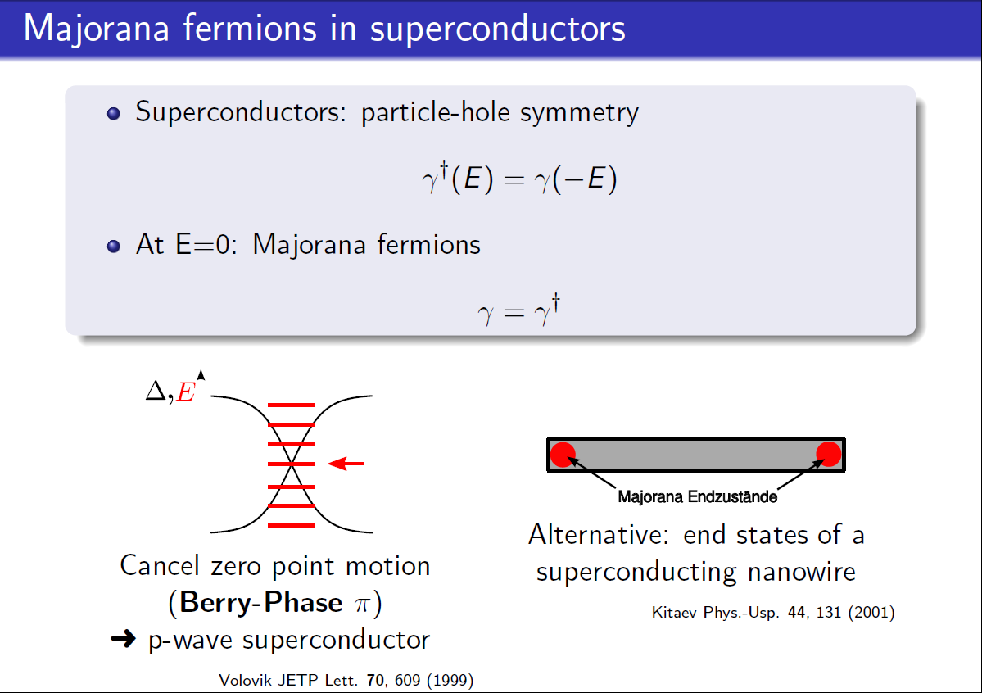

Slide 5
EPJ Special Topics volume on "New directions in the physics of one-dimensional electron systems"

Slide 6
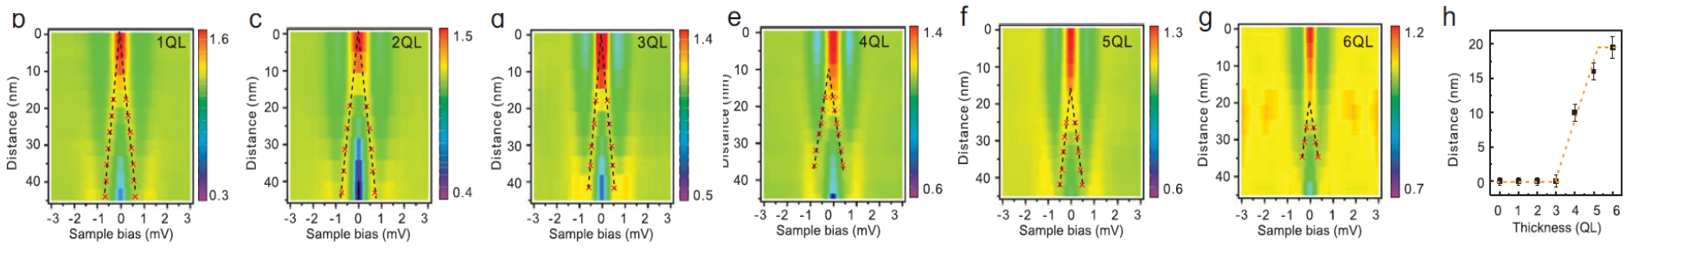

Slide 7
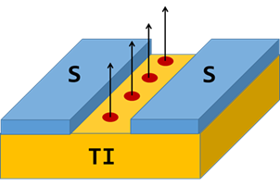
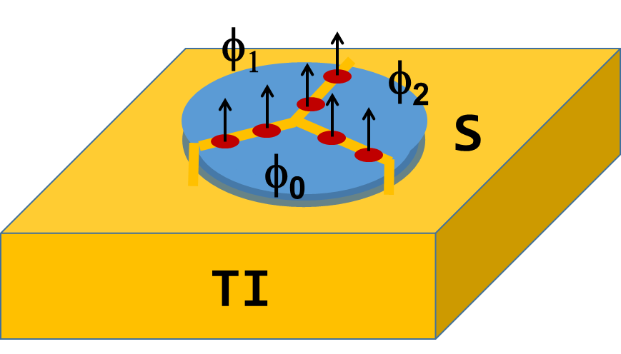
S-TI-S Josephson junction networks: a platform for exploring and exploiting topological states and Majorana fermions
Agenda
1. Topological insulators and Majorana fermions --- very little, but enough
Why junctions might be better than nanowires
The model --- what we think should happen
The experimental picture --- what we see
Mysteries --- what we still need to understand
Functionalization
  Imaging --- finding Majorana
  Braiding
  Parity readout
  Quantum processors

Slide 8
Most attention to date --- semiconductor nanowires
B
Semiconductor nanowire
Superconductor
Advantages:
System can be tuned into the topological state with a magnetic field
Majorana fermions are stabilized at the ends of the wire
Parity lifetimes are expected to be long (few other states around)
Can probe zero energy states via quasiparticle tunneling spectroscopy
Disadvantages:
Need a large oriented magnetic field to induce the topological state
Majorana fermions are stabilized at the ends of the wire
Challenging to manipulate/braid Majorana fermions

Slide 9
Why lateral S-TI-S junctions?
Not the favorite system of most because of the complexity:
2D width (multiple channels)
Multiple surfaces (top, edges, bottom)
Conducting bulk states and trivial surface states in the TI
  Advantages:
  Supports topological excitations without a strong magnetic field. Allows phase-sensitive techniques, e.g. Josephson interferometry
  Allows access to barrier for probes and imaging
  Expandable into networks
  Enables multilple modes of operation to move and control Majorana fermions by phase, current, or voltage
  Schemes proposed to braid and perform logical operations.
Trade-off stability for functionalization !

Slide 10
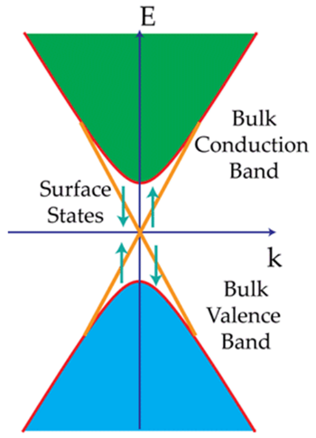
Key component: S-TI-S lateral Josephson junction
2e
S-I-S
insulator barrier
Correlated tunneling of electrons
“Cooper-pair tunneling”
θ₁
θ₂
e
S-N-S
normal metal barrier
Coherent electron-hole pair transport
with Andreev reflection at SC interface
“Andreev bound states”
θ₁
θ₂
h
e
S-TI-S
topological insulator barrier
Coherent electron-hole pair transport via topological surface states
“Andreev bound states” +
“Majorana bound states” (zero-energy)
θ₁
θ₂
h
3D
topological insulator
Insulating bulk (nearly)
High-mobility surface states protected by topology
Spin-momentum locking prevents backscattering

Slide 11
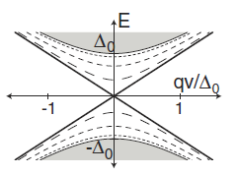
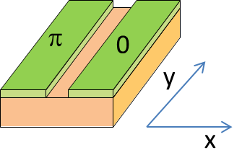

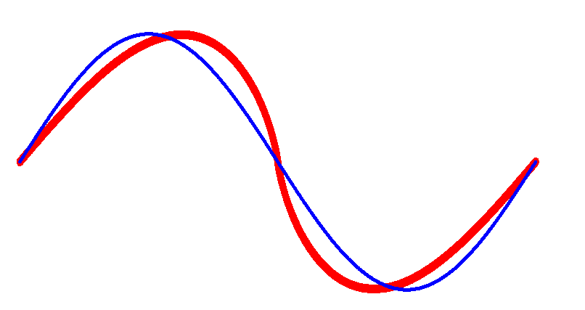
Andreev Bound States (ABSs) in S-TI-S Josephson junctions
L. Fu and C. Kane, Phys. Rev. Lett. 100, 096407 (2008)
φ
Zero-energy
Majorana
Bound states for φ = π
φ
ABS energy levels
for q=0
Supercurrent contribution
Low-energy ABS:
for q small, high transparency
(skewed CPR)
Majorana states:
for q=0
(4π-periodic CPR)

Slide 12
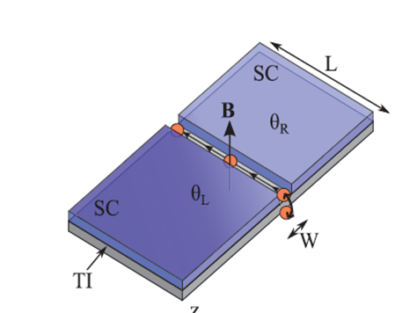
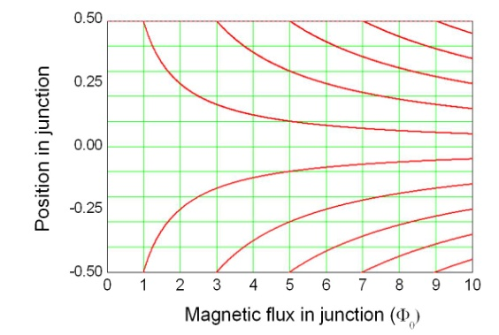
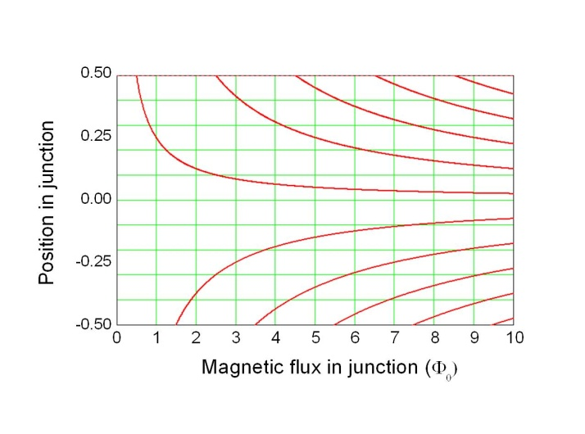
Current-controlled devices: lateral junctions in a magnetic field
Perpendicular magnetic field induces a phase gradient and circulating currents
Potter and Fu
Zero current: MFs enter symmetrically
 B
φ
I=I_{c}
4π
I=0
3π
2π
At critical current: MFs enter alternatively
π
x
4Φ₀
Majorana fermions enter junction attached to Josephson vortices --- located where the phase difference is an odd multiple of π

Slide 13
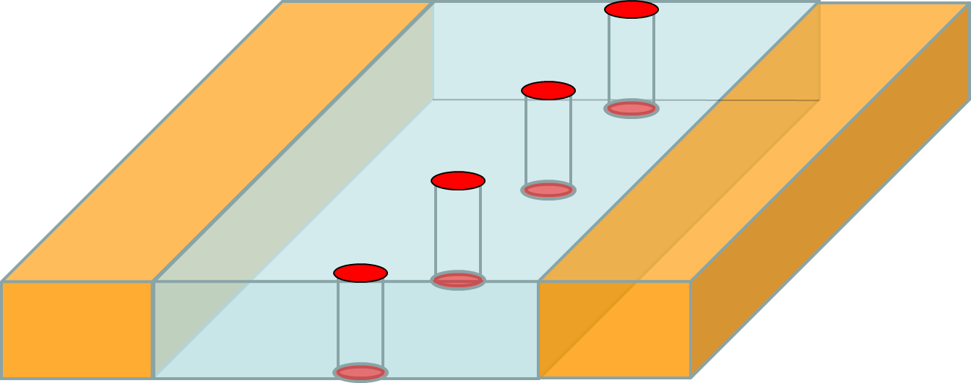
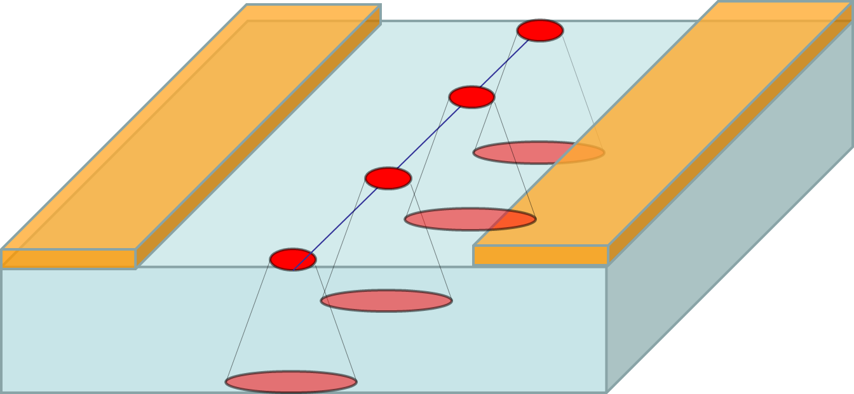
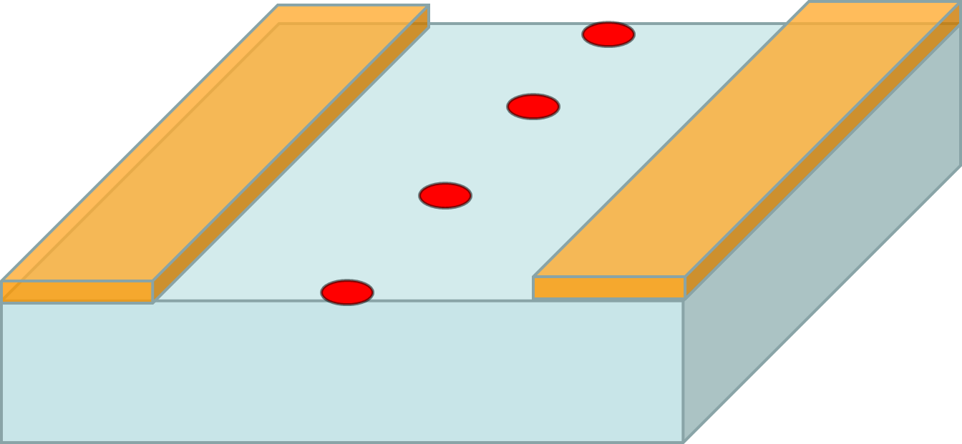
Where is the other Majorana?
Symmetric configuration:
MFs on top and bottom surface connected by a vortex,
series of nanowires in the barrier
supercurrent on both surfaces
Asymmetric configuration:
lateral junction
MFs on localized on top surface, delocalized on bottom surface
supercurrent only on top surface
Extreme asymmetric configuration:
Consider only MFs on top surface, partners are fully delocalized

Slide 14
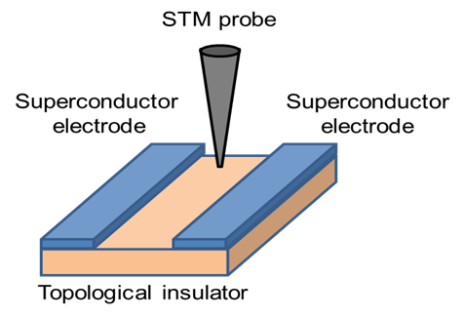
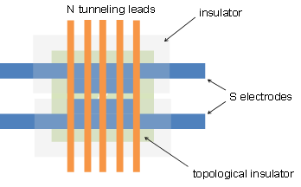
Detecting localized Majorana fermions via tunneling spectroscopy
Can scan an STM to map out the location of Majorana fermions
(experiments underway with Michigan State -Tessmer)
Or move Majorana fermions bound to Josephson vortices under fixed tunnel junctions

Slide 15
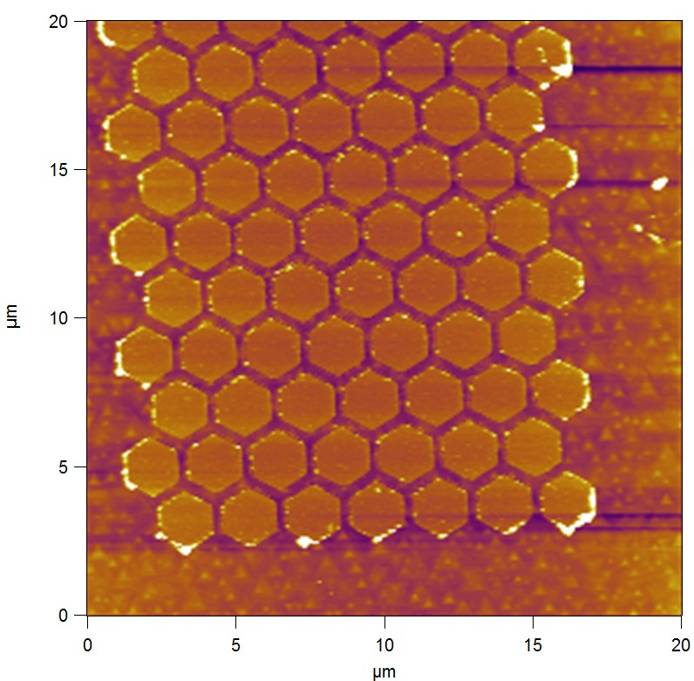
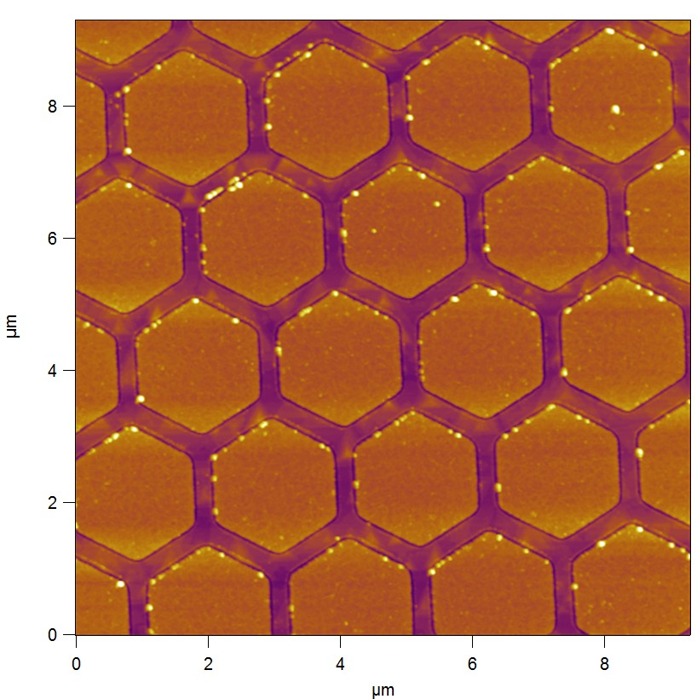
S-TI-S arrays for STM and SSM imaging
AFM images of Nb hexagons on Bi₂Se₃
This will be a suitable platform for multiple braiding operations by controlling magnetic fields and island phases

Slide 16


Voltage-controlled devices: moving Majorana fermions
Phase winds according to the Josephson relation:
Majorana fermions move laterally through junction at speed:
d
 B
For V = 1 μV and d = 100 nm and B = 10 mT, v = 1 km/s!
Provides way to move Majorana fermions fast along lateral junctions
Can manipulate MFs in multiply-connected junction networks for braiding

Slide 17
Braid MFs by phase-control of islands
Braiding operations
CNOT gate

Slide 18
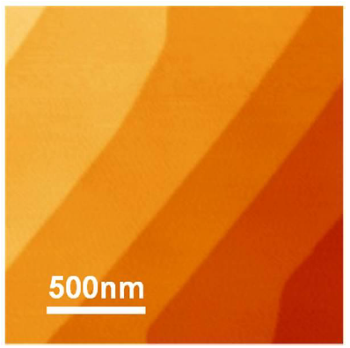
Bi₂Se₃ Materials Characteristics
Bi₂Se₃ film MBE-grown on Al₂O₃
Bulk is insulating - conductance is dominated by two surface channels:
  Trivial 2DEG (2-3 quintuple layers)
  Topological surface state
This suggests that:
Most of the supercurrent is carried by the top surface.
Bulk conductance does not play a large role in the supercurrent properties.

Slide 19
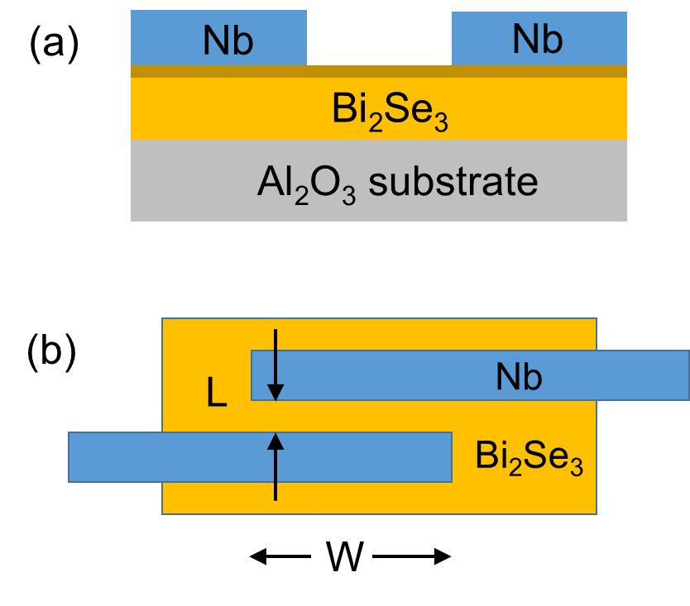
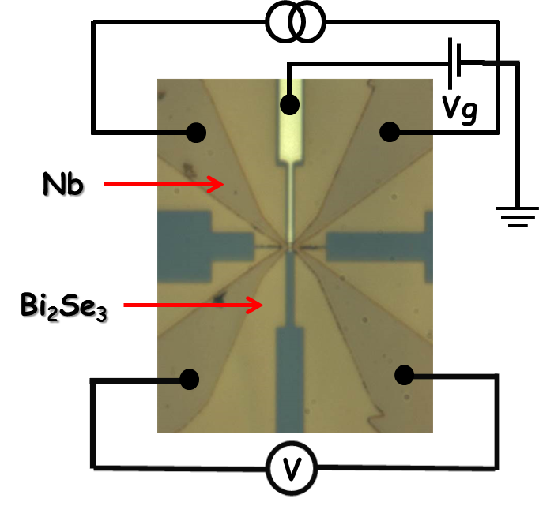
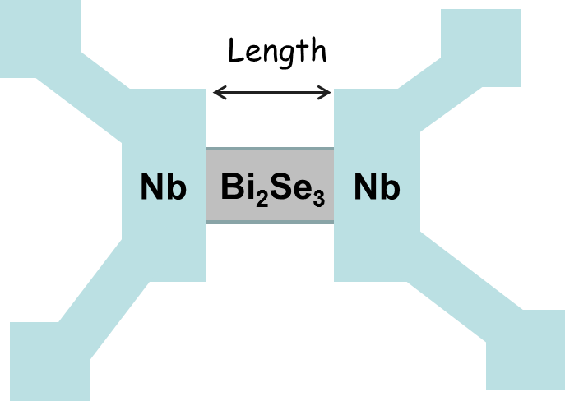
Nb/Bi₂Se₃/Nb Josephson Junctions
- E-beam lithography
- Ion milling
- Evaporation and sputtering
Typical Dimensions:
Length = 100-300nm
Width = 300nm-1μm
Width
Top gate dielectric ~ 35-40nm
(ALD Al₂O₃/HfO₂)

Slide 20
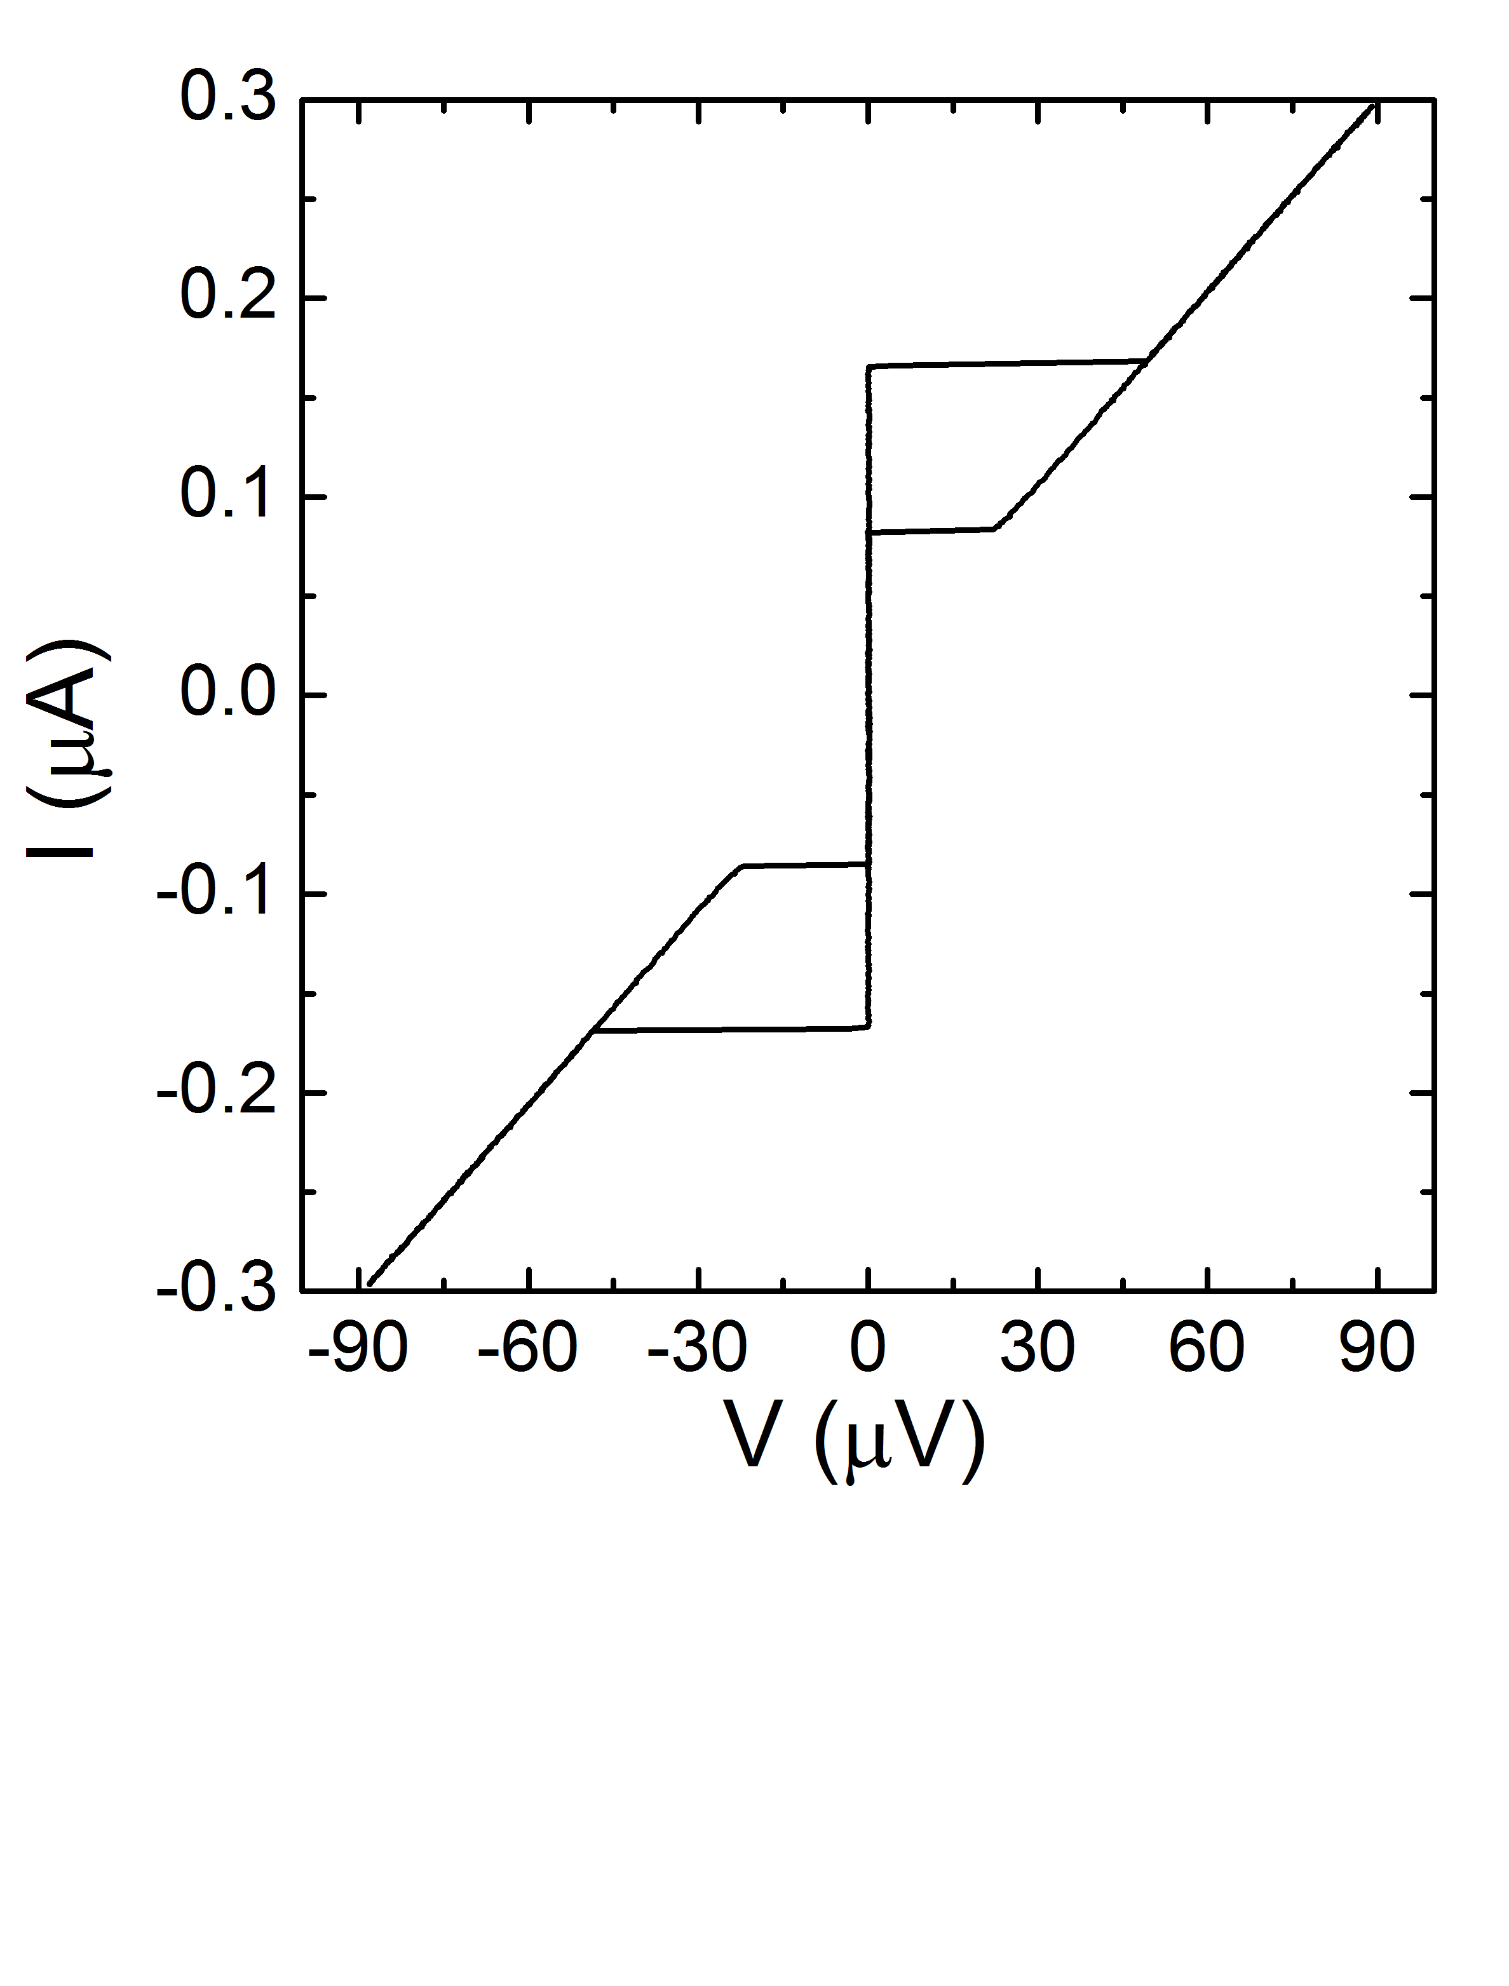
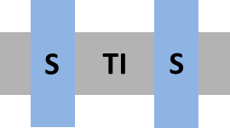
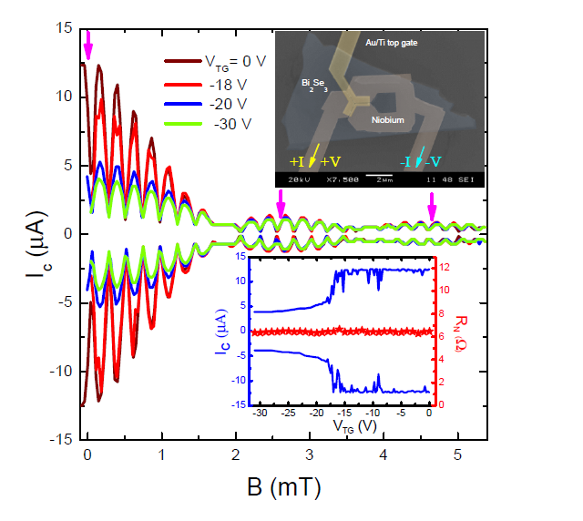
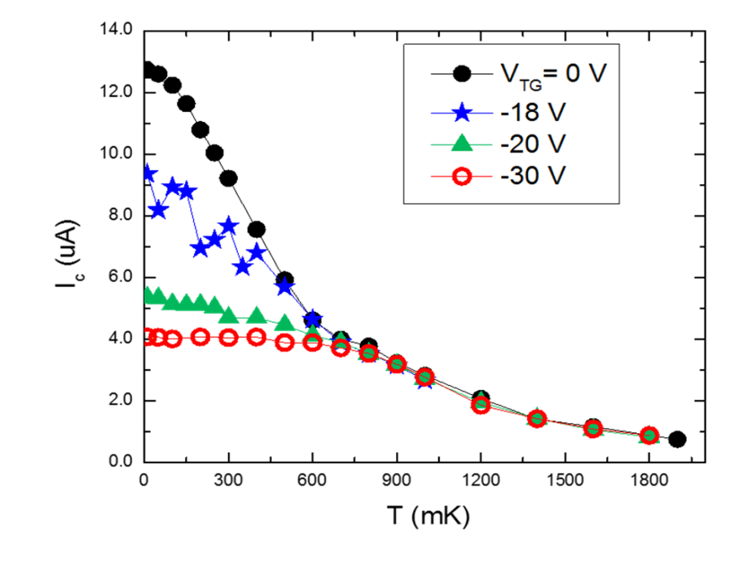
Supercurrents
Gate voltage dependence
Temperature dependence

Slide 21
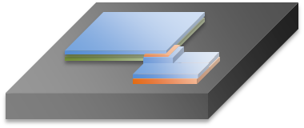
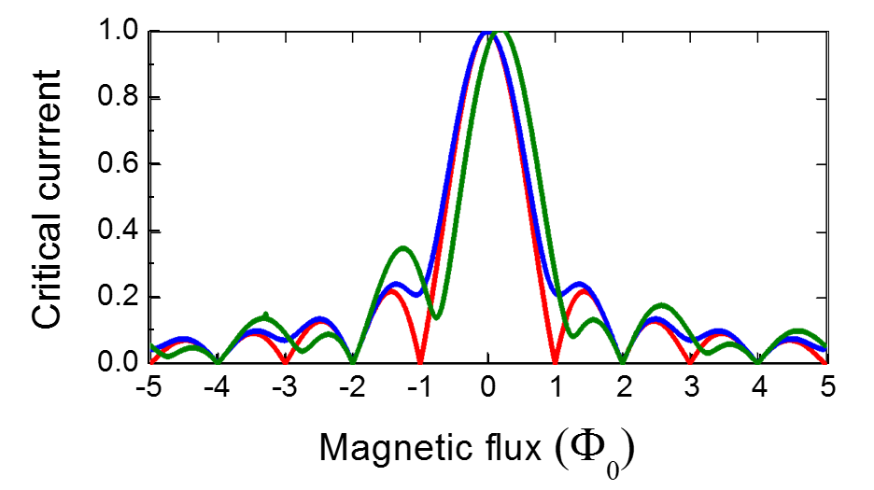
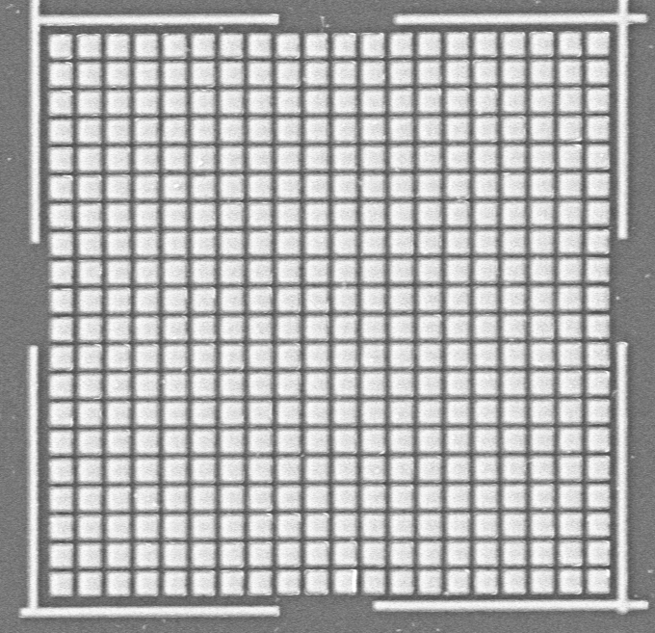
New questions of pairing symmetry --- opportunities for Josephson interferometry
Current focus is on topological systems --- interplay of topology and superconductivity
Superconductor/Topological Insulator bilayers and arrays
Corner Junction experiment to test for proximity-induced p-wave symmetry
S-TI bilayer
N barrier
S electrode
s + (p_{x}+ip_{y})
s + p
Bilayer sample
Array samples

Slide 22
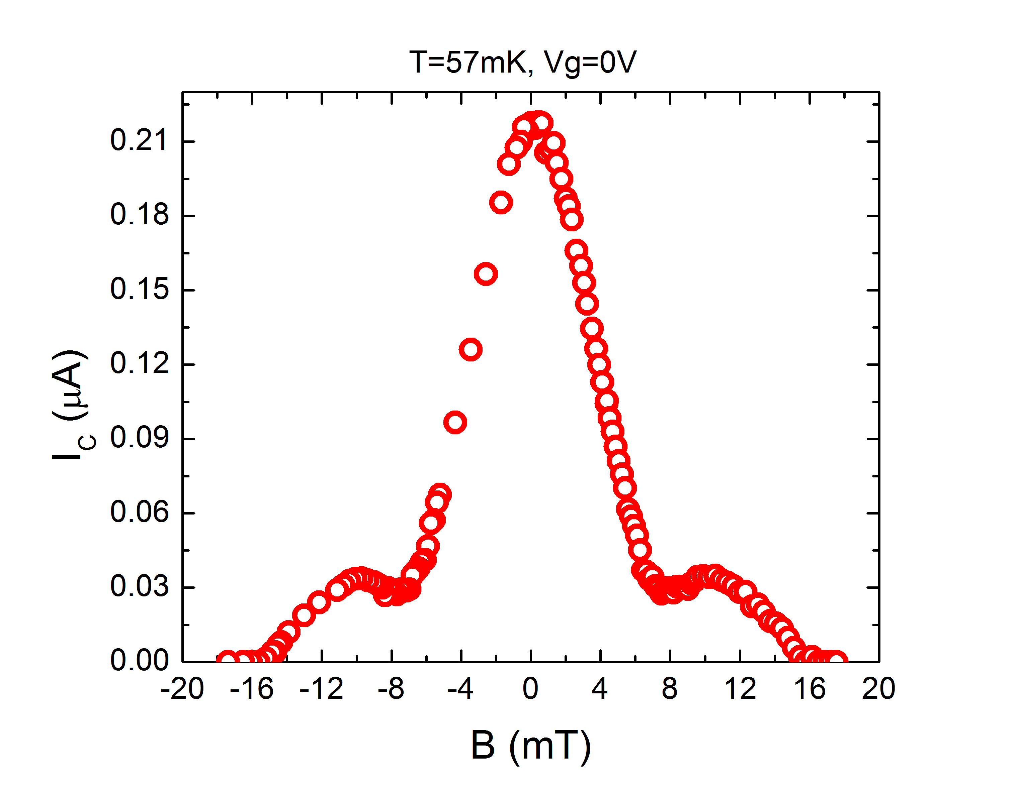
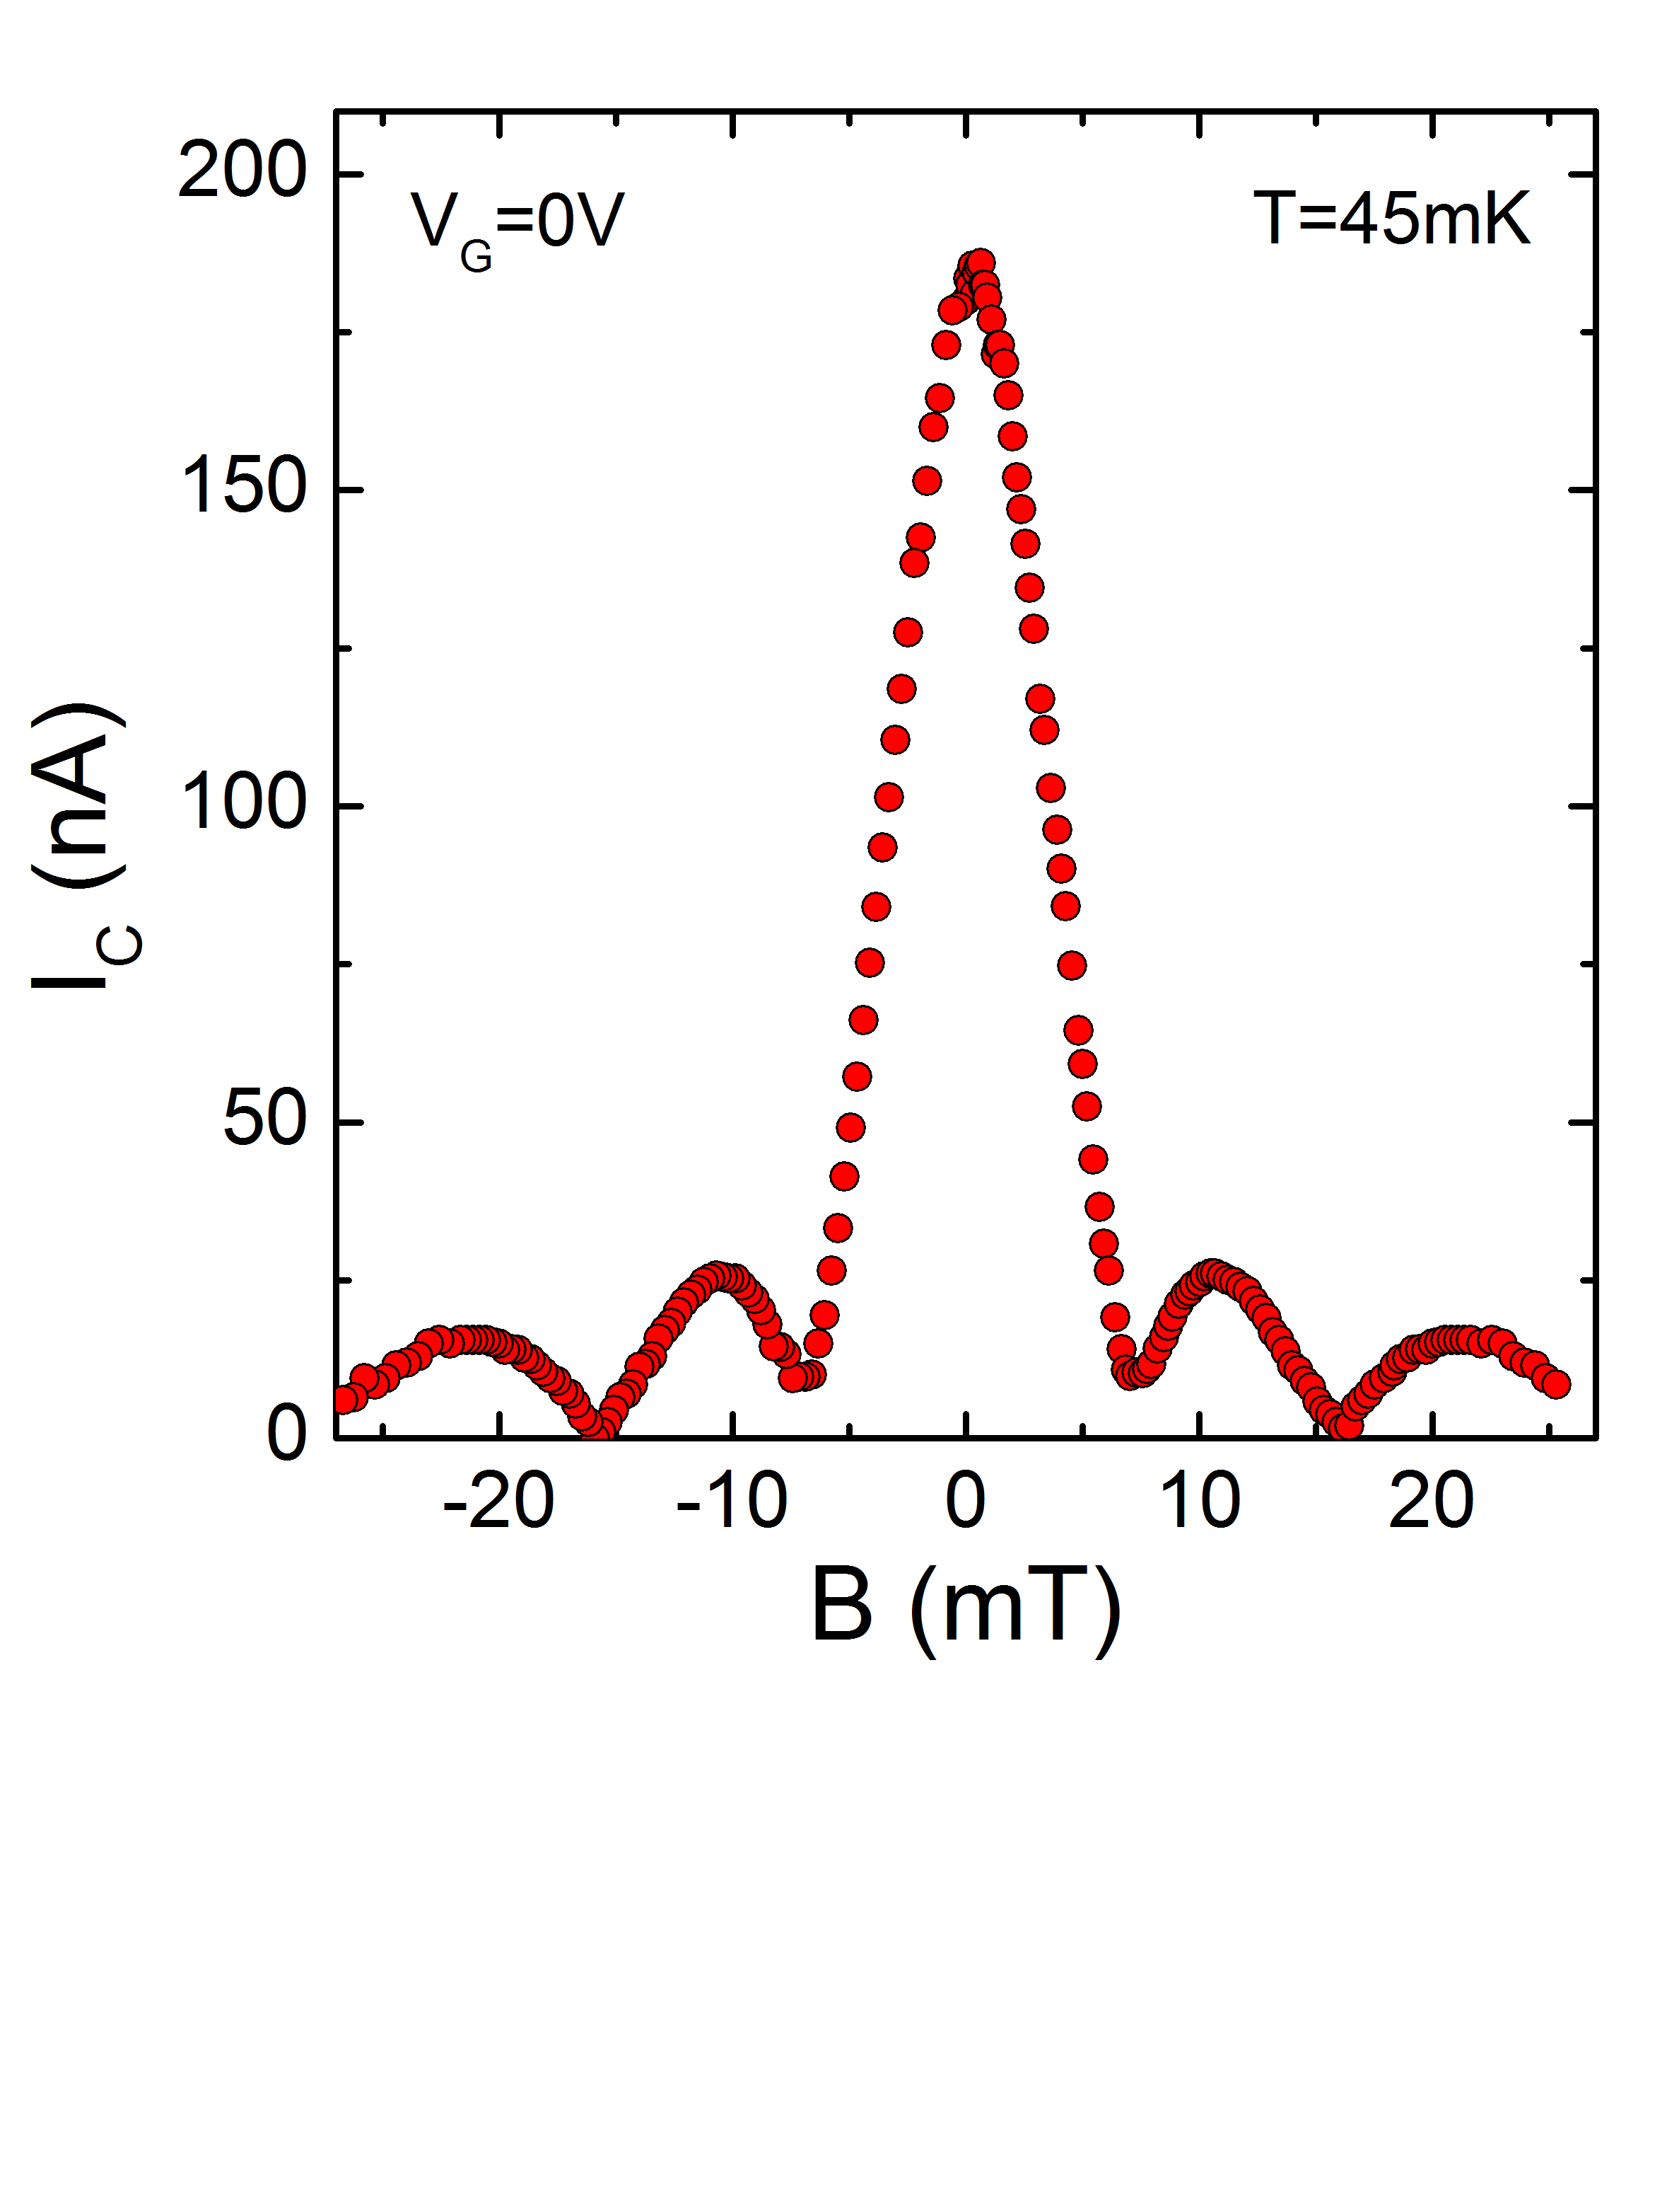
Supercurrent diffraction patterns
1st minimum does not go to zero
2nd minimum does go to zero

Slide 23
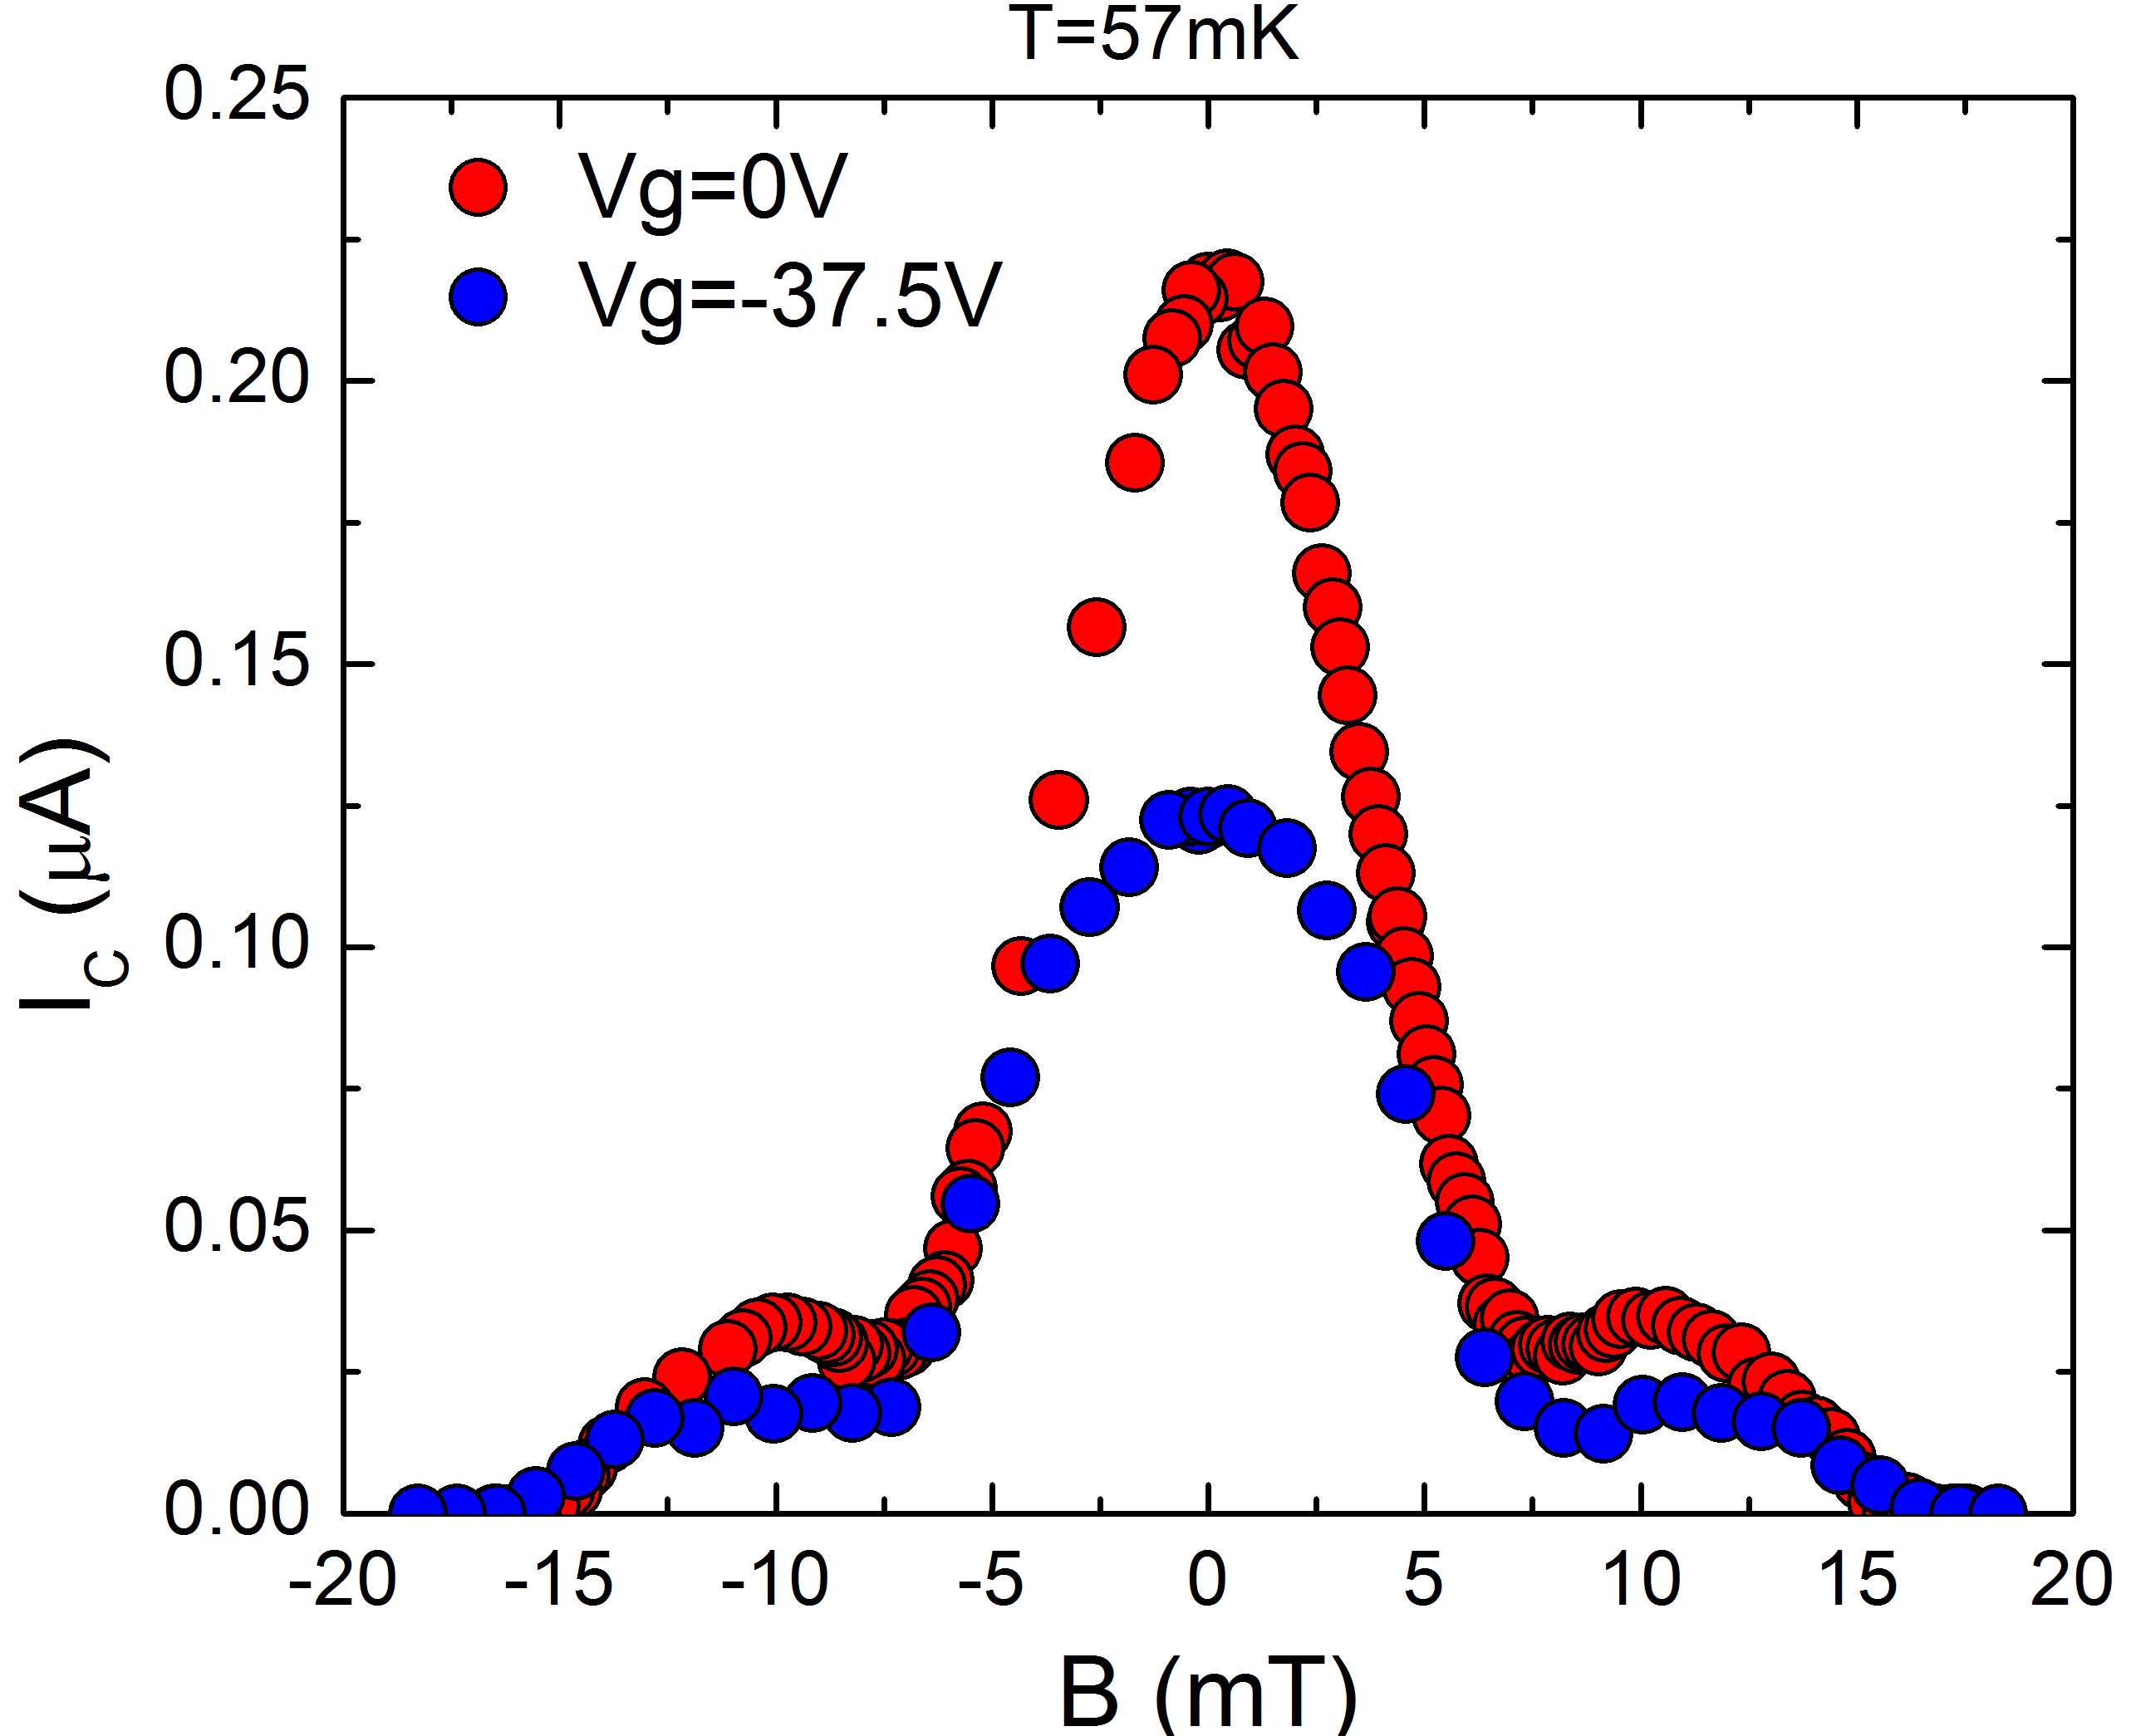
Diffraction pattern vs. gating
MBE-grown barrier
exfoliated barrier
Central peak drops at Dirac point
Side lobe is nearly unchanged
Lifting of first node persists

Slide 24
Diffraction pattern --- higher level nodes
Question always arises whether higher-order nodes are lifted --- difficult to test because the critical currents are very small
In this junction, 1st and 3rd nodes are lifted, 2nd and 4th nodes are hard ….
but extra bump at higher fields indictiong some junction inhomogeneity

Slide 25
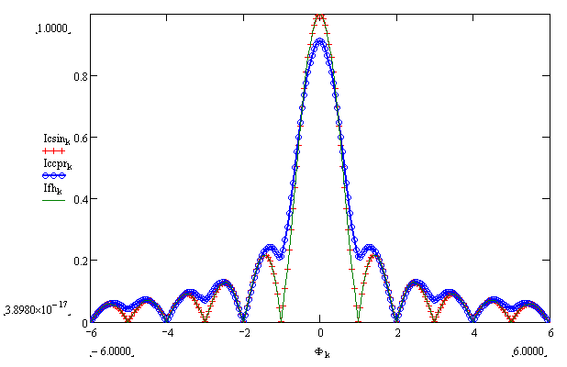
Simulations --- Hybrid Current Phase Relation
CPR: I(φ,V_{g}) = Ic₁ sin(φ) + Ic₂(V_{g}) sin(φ/2)
1st minimum lifted
2nd exactly nulled
Reproduces some key features
However, this assumes a uniform sin(φ/2)-component with should not be the case for Majorana fermions --- only stable when φ ~ π

Slide 26
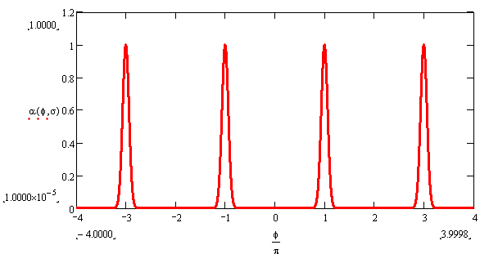
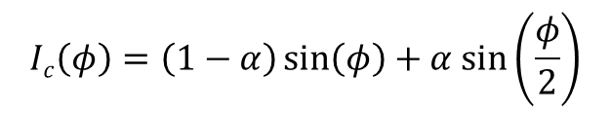
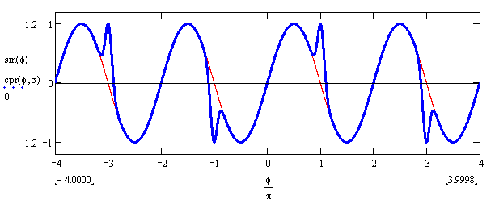
Model --- Current-Phase Relation for S-TI-S junction
Majorana fermions nucleate when/where the phase difference is π
Width of the Majorana region will depend on details of the sample
Consider the junction to break up into 1D wires with a sin(φ/2)-component

Slide 27
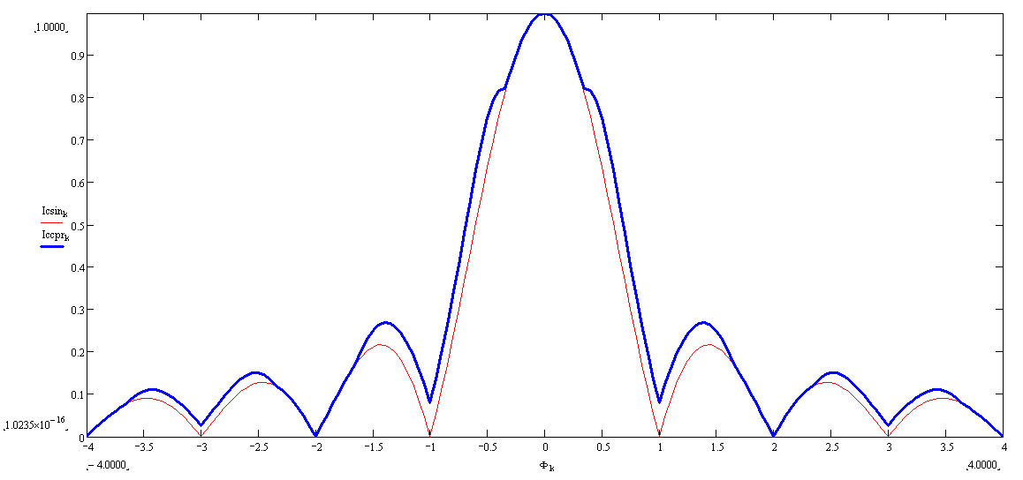
Diffraction patterns for S-TI-S junction
I_{c}
Φ
Lifting of odd nodes
Additional structure when Majorana fermions enter the junction ---
a signature of a localized sin(φ/2) component in the CPR

Slide 28
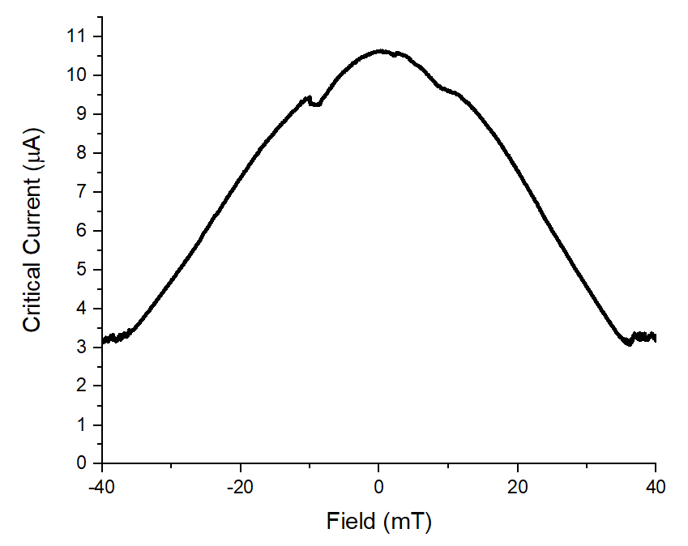
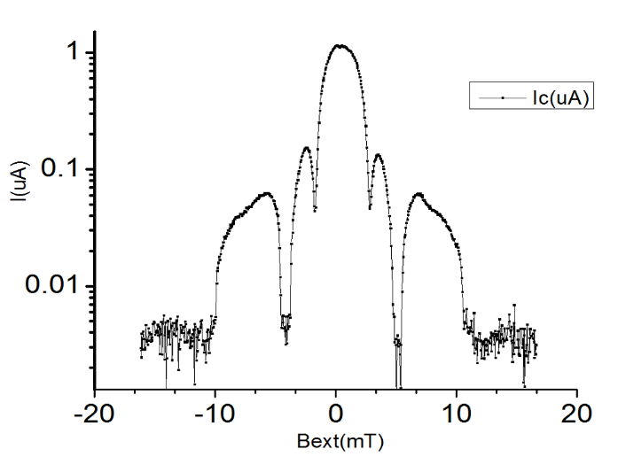
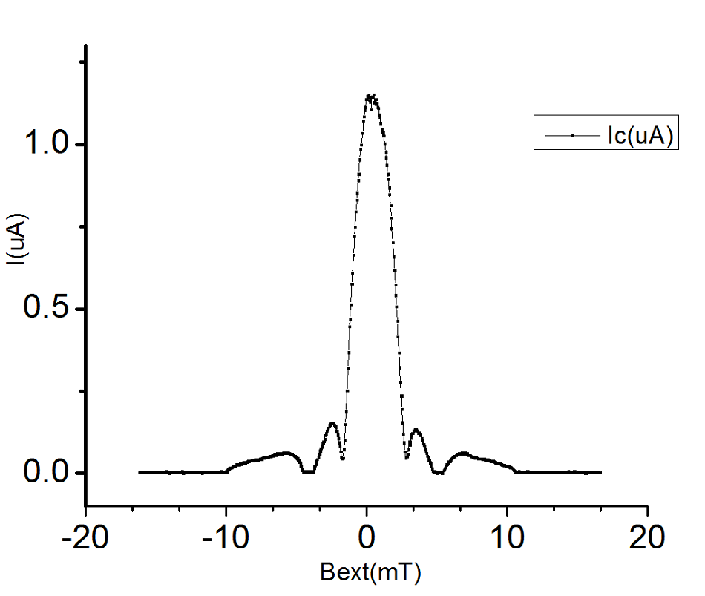
Josephson vortex + Majorana Fermion entry features
Model predicts an increase in the equilibrium supercurrent when the first vortex/MF enters the junction
We observe these features in the diffraction pattern
Important feature --- indicates that MF modes are localized and when they are in the junction
Entering features

Slide 29
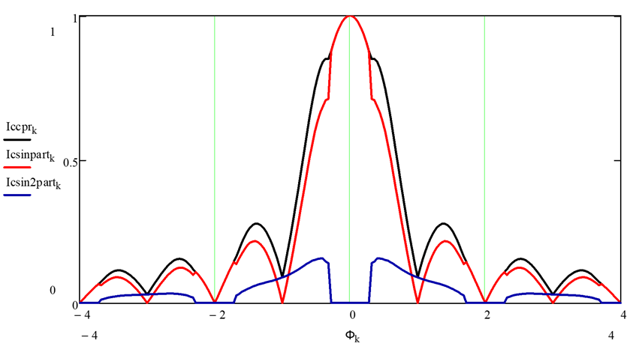
Current carried by Cooper pairs vs Majorana fermions
I_{c}
I_{c} sin(φ)
I_{c} sin(φ/2)

Slide 30
S-TI-S dc SQUID
Motivation: can use SQUID loop to adjust relative phase of the junctions and control the Majorana fermions
Gate-1
~2.5 um
~2.4 um
I
V
Nb leads
Gate-2
Bi₂Se₃ ribbon
Bi₂Se₃: 19 nm thick , 4 μm long, 300 nm wide exfoliated piece
Junctions: length 300 nm, width 300 nm
Area loop ~ 6 μm²
Area junction ~ 0.9 μm²
ratio ~ 60

Slide 31
SQUID oscillations --- gate dependence --- envelopes
Envelopes exhibit same behavior as single junction diffraction:
first node stays high, second vanishes
SQUID oscillations also do not go to zero as would be expected for β<<1 and a symmetric SQUID
β = 2πLI_{c}/Φ₀

Slide 32
SQUID oscillations --- gate dependence
Modulation depth is gate-dependent: peaks drop; nodes stay constant

Slide 33
Node-lifting in Josephson junctions and SQUIDs
Josephson junctions:
Inhomogeneous current distribution --- usually lifts all nodes
sin(φ/2)-component in the current-phase relation
Edge currents due to MF hybridization (Potter-Fu model)
    dc SQUIDs:
sin(φ/2)-component in the current-phase relation
Finite inductance of SQUID loop β = 2πLI_{c}/Φ₀
Asymmetry in the junction critical currents α = (Ic₁-Ic₂)/(Ic₁+Ic₂)
Asymmetry in the SQUID loop inductance η = (L₁-L₂)/(L₁+L₂)
    Skewness in the current-phase relation* s = (2φ_{max}/π) - 1
  * Skewness does NOT lift nodes in single junctions
  Ic_{min}/Ic_{max} ~ β ~ α ~ η ~ s

Slide 34
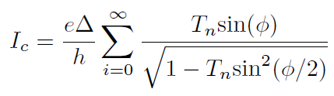
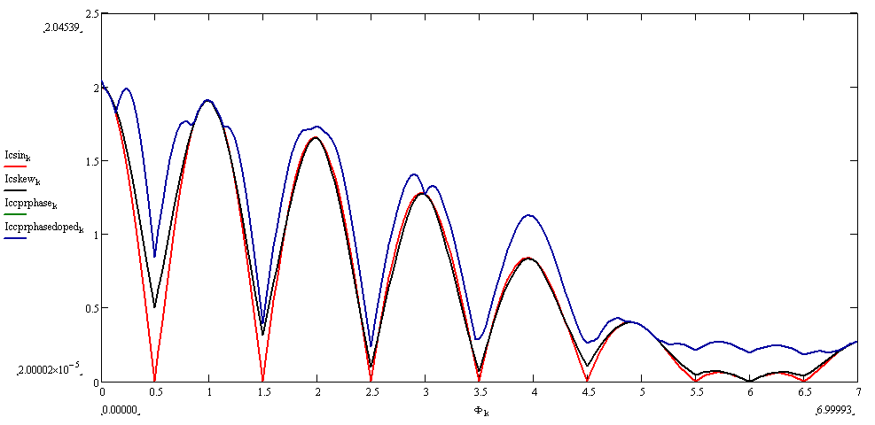
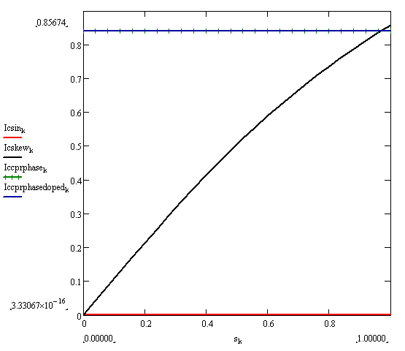

Simulations of skewed CPR on dc SQUID
  Skewness arises from transport through high transparency quantized Andreev bound states
Node-lifting vs. skewness
sin (φ)
sin (φ/2)
skew (φ)

Slide 35
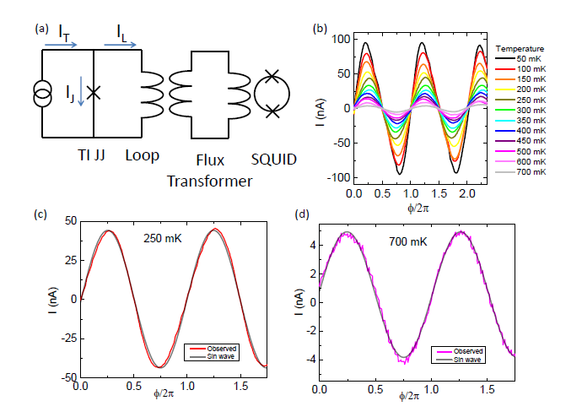
CPR Measurements via Interferometer technique
No 4π-periodicity --- expected for a static measurements
Very small skewness but need to measure when gated

Slide 36
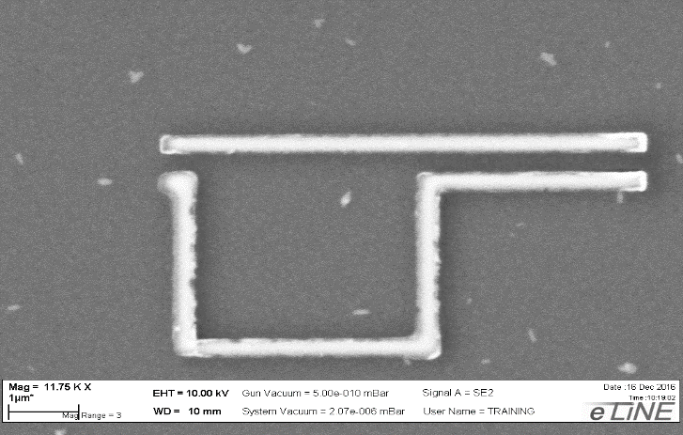

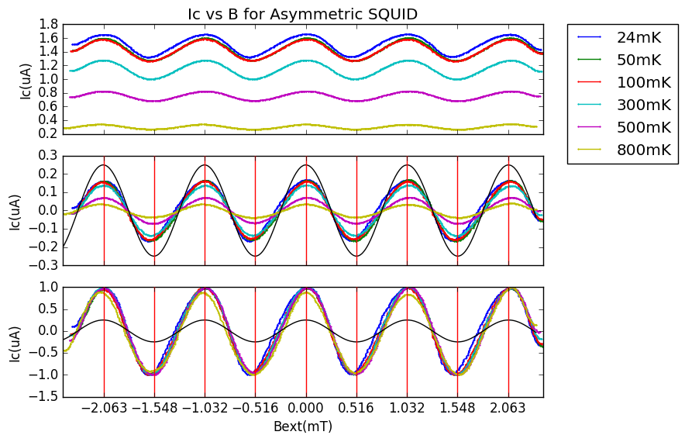
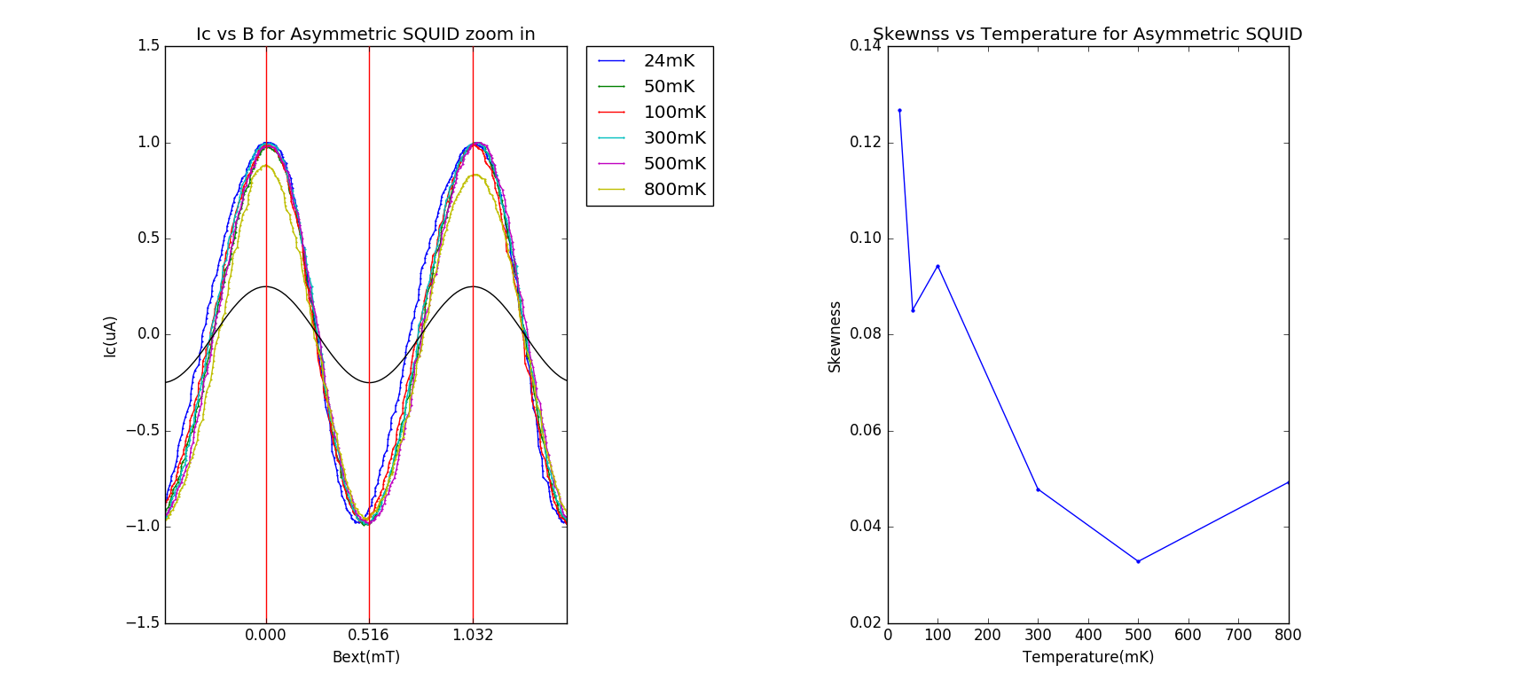
Frequency-dependent CPR Measurements
Asymmetric dc SQUID technique
I_{c1}
I_{c2}
Junction embedded in a dc SQUID
Measure critical current vs. flux
Modulation mirrors the CPR of the small junction for I_{c1} << I_{c2}
I_{c}
Skewness
Φ
T
Modulation shows skewness expected from high transparency states, but no signatures of sin(φ/2)  not there? suppressed by qp poisoning?

Slide 37
Moving on --- next steps
Status of experiments : Intriguing evidence for Majorana modes  most features we expect are observed
Who is convinced?
What do we do next?
NOBODY (as in all Majorana systems to date)
BRAID
Need to demonstrate braiding --- parity changes associated with MF exchange AND their non-Abelian statistics
Need to exchange MFs
Need to measure the parity
Need to measure parity lifetimes to determine how fast we need to perform braiding operations
Then we build a quantum computer

Slide 38
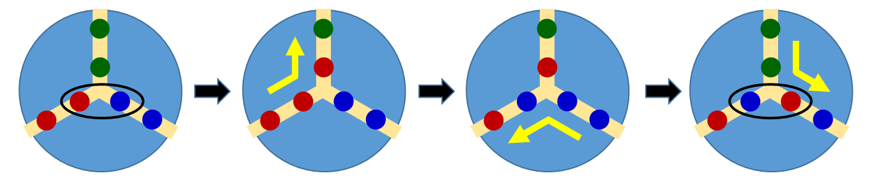
Ways to braid
Exchange braiding --- interchange MFs, change parity
Topologically-protected --- no errors
Hybridization braiding --- interact MFs, induce parity change
Not fully protected --- must control strength and time of coupling
Coupling depends of overlap of wavefunctions --- exponential dependence.

Slide 39
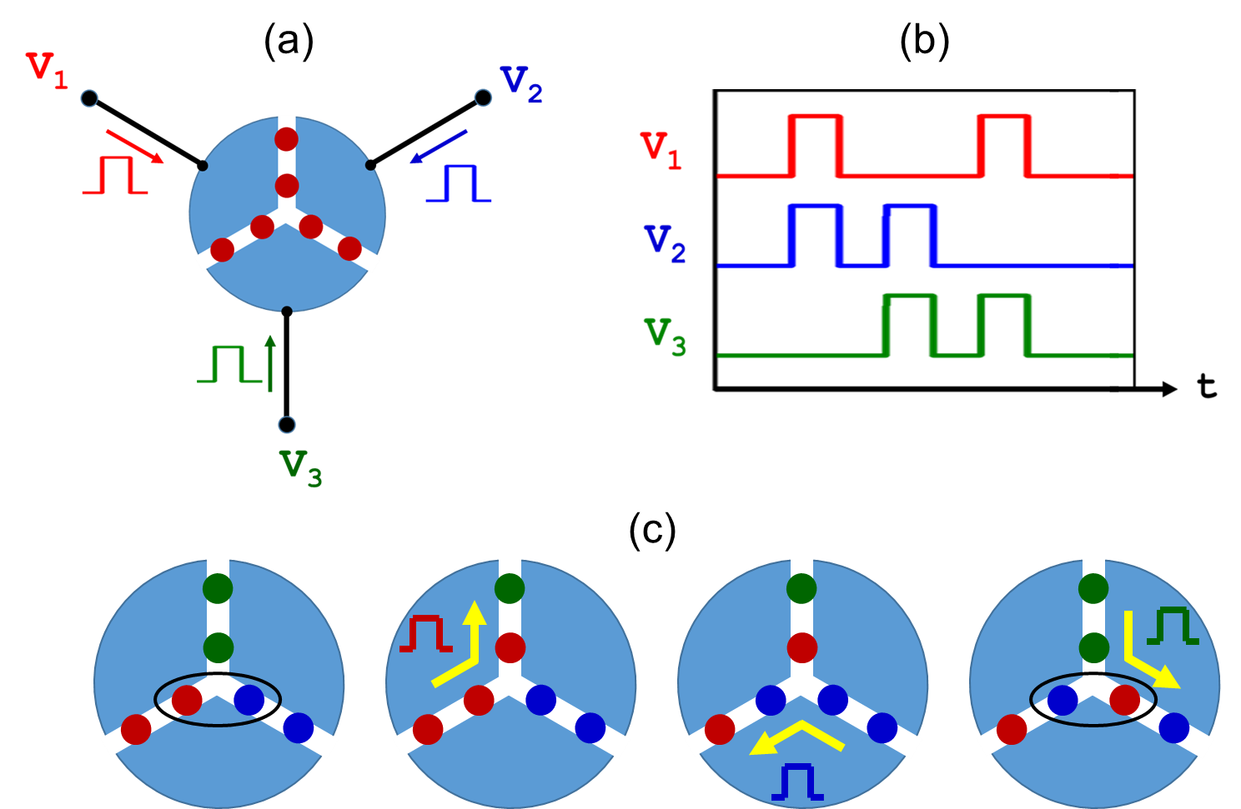
Exchange braiding in S-TI-S trijunctions via voltage pulses
Use voltage pulses to drive Josephson vortices/MFs
Utilize RSFQ (Rapid Single Flux Quanta) pulses (V*Δt = 1 Φ₀)
Apply sequences of pulses to junctions
Exchange vortices
Can braid rapidly but voltage pulses can generate quasiparticles that enhance parity switches → “quasiparticle poisoning”

Slide 40



Exchange braiding in S-TI-S trijunctions via phase shifts
Apply current pulses to junction arms shorted by inductors
Response is non-linear due to supercurrent in the junction
Allows continuous control of phases with no dissipation --- any phase configuration is accessible
Can braid rapidly but no voltages are generated, preventing quasiparticle poisoning

Slide 41


Hybridization braiding: controlling the spacing of Josephson vortices/MFs
Current in loop creates a local field pulse
Vortices move closer together
Creates hybridization –-- time-dependent
~20% change in MF position

Slide 42




Scanning SQUID Microscopy (SSM)
Technique developed in the 1980’s by UIUC/DVH group and IBM/Stanford.
SQUID detector scanned over surface to map the local magnetic field
x-y scan
hinge
10μm
100μm
Spatial resolution:
10μm
Flux sensitivity:
10⁻⁶ Φ₀
Square arrays
Triangle arrays
YBCO films
MoGe films

Slide 43
Indirect signatures of Josephson vortex MF control --- diffraction pattern spectroscopy
sin φ only
Differences with and without MFs
-5 -4 -3 -2 -1 0 1 2 3 4 5
Φ/Φ₀
with MFs
-5 -4 -3 -2 -1 0 1 2 3 4 5
Φ/Φ₀
-5 -4 -3 -2 -1 0 1 2 3 4 5
Φ/Φ₀

Slide 44







Imaging Josephson vortices via Scanning SQUID Microscopy (SSM)
JJ with sin(φ) CPR
With Majorana states
SSM probe
I
I
Bimorph x-y scanner
Sample and Helmholtz coil
Piezo z-control
Inertial walker
xy-positioning
y
y

Slide 45



Imaging feasibility --- junction simulations
Determining the required spatial resolution and flux sensitivity to image Josephson vortices – currents and fluxes are small
Sensor area = 1μm²
Height = 100nm
Vertical magnetic field (at pickup loop height)
Flux in pickup loop
of SQUID sensor
Φ_{applied}(Φ₀)
Supercurrent
5
W = 10μm
4
L = 300 nm
3
I_{c} = 100 μA
I
B_{z}
Φ_{SQUID}
2
1
0
-5 0 5
-10 -5 0 5 10
-10 -5 0 5 10
y(μm)
y(μm)
y(μm)
To detect Josephson vortices at relevant fields, need spatial resolution of < 1 μm
7

Slide 46


Imaging feasibility --- junction simulations (continued)
Magnetic flux sensitivity
Sample –sensor distance
50
Height =
B_{Z}(μT)
0
Φ_{applied}= 0
h = 100 nm
h = 300 nm
h = 1 μm
Φ_{applied} = 5Φ₀
-50
50
y(μm)
-10 -5 0 5 10
0.025
B_{Z}(μT)
Φ_{SQUID}
(Φ₀)
0
Φ_{applied}= 0
Φ_{applied} = 5Φ₀
-50
-0.025
-10 -5 0 5 10
y(μm)
SQUID sensitivity needs to be ?
8

Slide 47
Braiding by hybridization
Braiding can also be effected by changing the spacing of Majorana fermions to induce phase shifts and subsequently reading out their parity

Slide 48


Ways to measure the parity
Many schemes have been proposed:
couple topological device to a quantum dot
observe parity –dependent conductance changes in a “single-electron transistor”
incorporate topological device in a microwave cavity resonator “transmon”
observe splitting of energy levels corresponding to parity states
measure critical current switching distribution
sensitive to the sign of the sin(φ/2)-component which encodes the parity
measure transition from zero voltage to finite voltage state
I_{c+} ~ sin(φ) + γ sin(φ /2)
I_{c-} ~ sin(φ) - γ sin(φ /2)
Expect to see switching with a bimodal distribution --- splitting would be proportional to the magnitude of the sin (2φ) component

Slide 49

Critical current -- escape phase particle from the potential well
Thermal activation (over barrier)
Macroscopic Quantum Tunneling (though barrier)
S-I-S junction
I(φ) = I_{c} sin(φ)
single barrier heights ~ I_{c}
Single distribution
U
U
P
φ
φ
I
S-TI-S junction
I(φ) = I_{c1} sin(φ) + I_{c2} sin(φ/2)
Two barrier heights ~
I_{c1} ± I_{c2}
Bimodal distribution
U
P
φ
I

Slide 50









Critical current switching distributions
0.28 Φ₀
0.55 Φ₀
Low-field distributions exhibit conventional single peak form characteristic of escape from washboard potential wells
Above ~0.28Φ₀, we observe a broadened distribution --- bimodal but with intermediate states
Above ~0.55Φ₀, distribution narrows when junction is no longer hysteretic
Count

Slide 51
Modeling the switching distributions
0-parity
1-parity
P(I)
I/I_{c}
Low-field distributions fit MQT form --- no temperature dependence observed (expected for low-capacitance lateral junctions)
Intermediate region fits a bimodal critical current with splitting comparable to the node-lifting --- attribute this to sin(φ/2) contributions from MFs with different parity
Switching between distributions arises from parity transitions --- estimate parity transition rate to be ~ 20KHz  parity readout but with low fidelity
⬆
First actual parity measurements made on a Majorana fermion pair by us, and maybe by anyone.
Notes:
The dashed curve is the standard distribution for thermal activation or MQT (they look pretty much the same) from a single washboard potential well for a sinusoidal CPR. The solid curves on either side show what we would expect if the critical current in increased or decreased by 1% by the sin(phi/2) term from the first MF. Instead of a bimodal distribution, we see the RED curve in which I allowed switching from the two critical currents but also values in between. I think the physics is that the escape can occur anywhere in that range because the parity can switch while the current is being ramped. It might be good to show this to demonstrate that we can fit the data in a reasonable way

Slide 52
More critical current switching distributions
In other samples, the splitting is so small that it only shows up as a broadened single peak --- measure distribution and the standard deviation
Peak where Majorana fermions dominate current (at first node)
A second peak where two Majorana fermions at present (at second node)
Spike at onset features
Drop in non-hysteretic region
Notes:
IV vs field CP516, fine CP517
Dist vs field CP518

Slide 53




Effect of parity transitions on diffraction patterns
Device 1
Device 2
Simulation
Magnetic Field (mT)
Magnetic Field (mT)
Device 3
Device 4
The first node lifting is usually seen on our devices
The second node sometime also lifts due to non-uniform parity of the MBS
Magnetic Field (mT)
Magnetic Field (mT)
Notes:
Can sample, Dev 2 CP85, Dev 3 CP 99 some plot.opju,

Slide 54





Architecture for an S-TI-S quantum processor
Basic building block:
7 hexagonal islands
12 junctions
6 trijunction braiding sites
Phase control for exchange braiding
Field coils for hybridization
Transmon readout of MF parity at 6 sites
E. Ginossar and E. Grosfeld
Nature Communications 5, 4772 (2014) |

Slide 55
The state of Majorana fermions in S-TI-S junctions
Theoretical models make specific predictions about Majorana fermions in S-TI-S Josephson junction networks. Our approach has been to:
(1) Test those predictions as rigorously as possible via transport and Josephson experiments
Coherent supercurrents on the top surfaces
Odd node lifting
MF entry features
Skewness in CPR
Evidence for parity fluctuations at higher order nodes
Critical current distribution splitting in some junctions; broadening in all
Node-lifting seems too large in some junction
Splitting seems too small in some samples
No observation of 4π-periodcity in direct CPR measurements
Move forward on schemes to braid and readout parity that can provide the only definitive proof of MFs with non-Abelian statistics and enable applications

